Slide 1
Location Recommendation for Opening an Indian Restaurant in Toronto
Applied Data Science Capstone
IBM Data Science Professional Certification
Apoorva Sharma

Slide 2
Problem
While opening a restaurant can be a very lucrative business, a lack of demand causes many restaurants to close within the first year of opening
Factors for Restaurant’s Success: Location, Competition, Quality of Food
Business Problem: If the client wanted to open an Indian Restaurant in Toronto, what areas are the best options to open the restaurant?

Slide 3
Data
Data Sources:
Foursquare API
Toronto Census
Population & Ethnic Distribution of Each Neighborhood (Toronto Census)
Income Distribution of Each Neighborhood (Toronto Census)
Number of Restaurants in Each Neighborhood (Foursquare API)
Number of Indian Restaurants in Each Neighborhood (Foursquare API)
Latitude and Longitude of Each Neighborhood

Slide 4
Location of each postal code within Toronto, Canada.

Slide 5
Result of the clustering algorithm.
Cluster 0 = Red Cluster 1 = Purple Cluster 2 = Blue Cluster 3 = Turquoise Cluster 4 = Orange

Slide 6
Characteristics of the clusters resulting from k-Means clustering algorithm
Cluster | Characteristics
Cluster 0 | Positive Spending Power (0.3 – 1.8)
Cluster 1 | Negative Spending Power (-1.2 -- -0.8)
Cluster 2 | Near Zero Spending Power (-0.5 – 0.5)
Cluster 3 | High Positive Spending Power (1.7+)
Cluster 4 | Negative Spending Power (-0.8 – 0) With Large Number of Restaurants

Slide 7
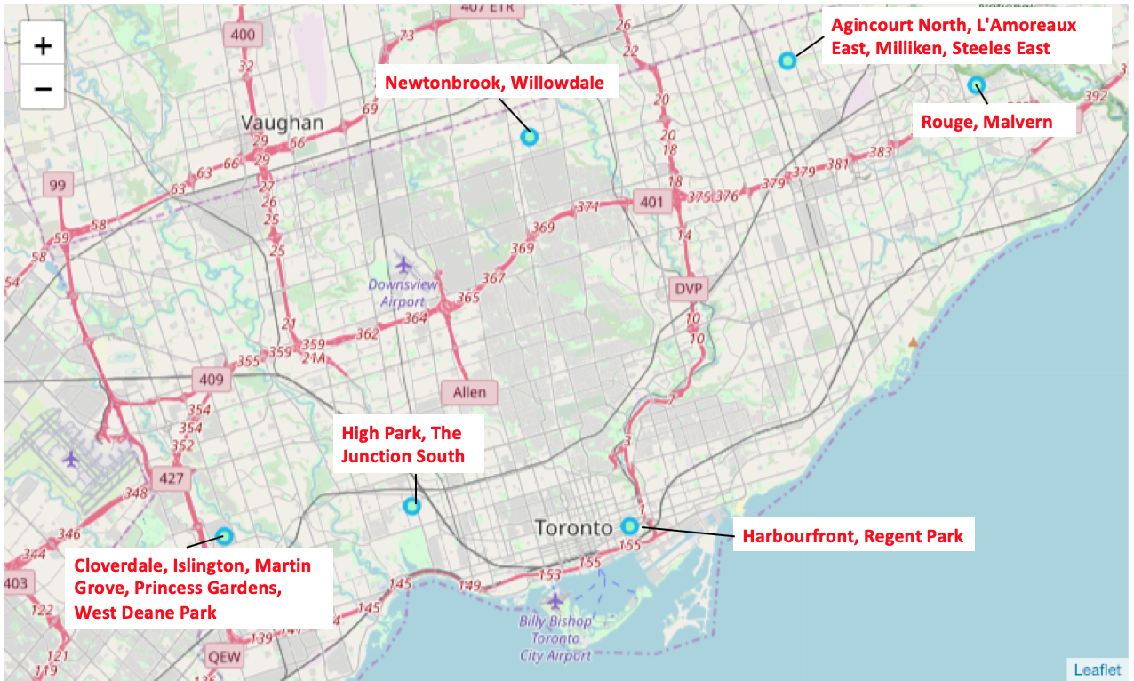
Map of Toronto with the neighborhoods in Cluster 3 labeled.

Slide 8
From the plot, the following areas can be eliminated due to the large number of areas:
Agincourt North, L’Amoreaux East, Milliken, Steeles East
Newtonbrook, Willowdale
High Park, The Junction South

Slide 10
The population of each region is relatively the same.

Slide 11
Rouge, Malvern region has the highest percentage of South Asians and thus the demand will be higher in the region.

Slide 12
Conclusion
The recommended location to open an Indian restaurant in Toronto, Canada would be the Rouge, Malvern area.

Slide 13
Thank you !

